Slide 1
PROCESS GUIDE
Agenda
16:00-16:05 → Rollcall
16:10-16:40 → Introduce Process
16:40-17:00 → Introduce BPMN
17:00-17:05 → break time
17:05-18:00 → Guide to use Bizagi tool to draw process
18:00-18:30 → Question & Answer
Process dept.
Jan, 2023
Notes:
Objetive:
- Introduce about process, guide langue and tool so departments can have same language to communicate and build processes using in company

Slide 2
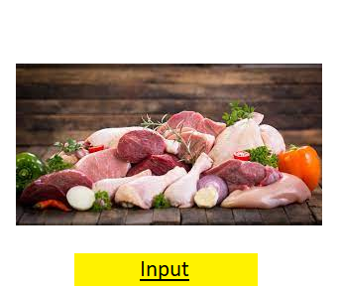

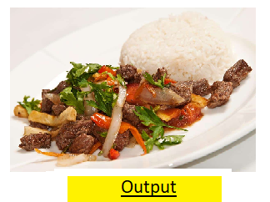
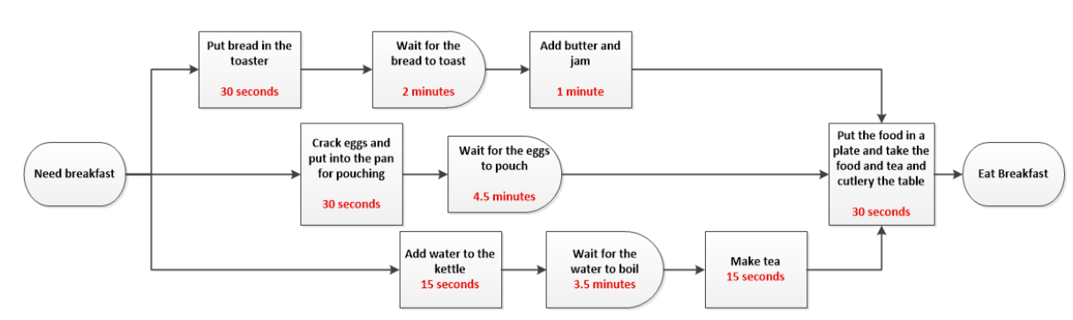
Introduce Process
What is a process?
Example: Preparing breakfast
Check the fridge
Choose a dish
Preprocessing
Cleaning
Washing
Prepare cooking ingredients
Cooking
Presenting
Then, what are the process’s components?
- Customer
- Event, boundary
- Input, out put
- Activity, Task, OLA
- Resource
- KPI
Notes:
Process: is a set of related activities performed by resources to convert defined inputs into expected outputs that satisfy customer needs of the process
Activity: is the work done in a specified period of time of the process
Task: are specific actions that need to be done to complete an activity
OLA: defines the level of service that one internal department or team within an organization agrees to provide to another internal department or team.
SLA: a contract between a service provider and a customer that defines the level of service the provider will deliver.
Resource: is the person and/or machine, device, software, or system that performs the activities in the process
Input: is the data, information, and materials used to implement the activities in the process
Output: is the result obtained after performing the activities in the process
Customer: is the object that uses the process output
Event: is something that happens at a time (not happening over a period of time like an activity)
Control flow: shows the relationship between activities and events in the process
KPIs : are the main criteria and indicators used to evaluate and measure process performance
Process boundary: defined by the process start and end events
Show directive: http://process.bitel.com.pe/

Slide 3
Introduce Process – RA(S)CI MATRIX
Abbreviation | Role | Description
R | Responsible | Those who do the work to complete the task. There is at least one role with a participation type of responsible
A | Accountable | The one ultimately answerable for the correct and thorough completion of the deliverable or task. An accountable must sign off (approve) work that responsible provides. There must be only one accountable specified for each task or deliverable.
S | Support | Resources which provide a supporting service role in implementation
C | Consulted | Those whose opinions are sought, typically subject-matter experts; There is two-way communication
I | Informed | Those who are kept up-to-date on progress, often only on completion of the task or deliverable; There is just one-way communication
Notes:
R: Responsible → the unit/person in charge of have the activity or task done, with expected quality, in expected time
A: Approve/Accountable → the unit/person in charge of approve the activity, if any
S: Support → the unit/person in charge of giving support service to do the activity/task
C: Consult → the unit/person in charge of giving consult/advise/information when requested, and those information must be considered
I: Informed → the unit/person will receive information/notification of an activity. It’s not mandatory to give feedback for the received information.
Link process index:
http://process.bitel.com.pe/
Path to directive about using bizagi in process
http://process.bitel.com.pe/
→ Information Technology Division → Directive about require to comply with regulations at Viettel Peru

Slide 4
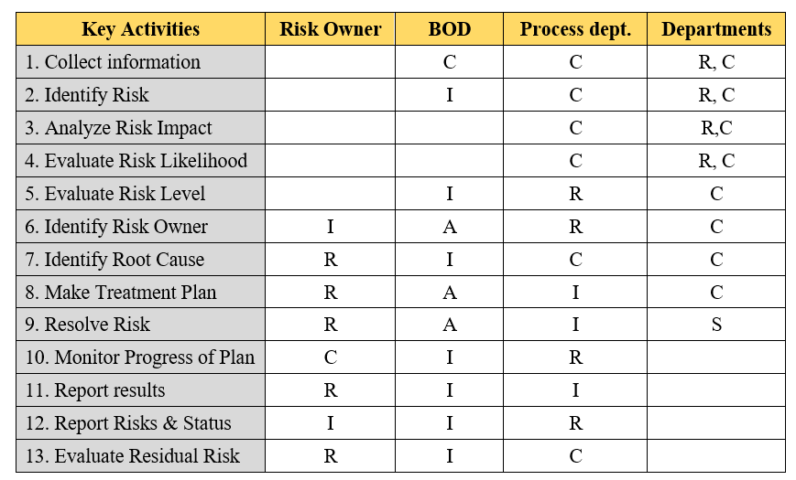
Introduce Process – RA(S)CI MATRIX
Example of RASCI matrix in Risk management process
Notes:
R: Responsible → the unit/person in charge of have the activity or task done, with expected quality, in expected time
A: Approve/Accountable → the unit/person in charge of approve the activity, if any
S: Support → the unit/person in charge of giving support service to do the activity/task
C: Consult → the unit/person in charge of giving consult/advise/information when requested, and those information must be considered
I: Informed → the unit/person will receive information/notification of an activity. It’s not mandatory to give feedback for the received information.
Link process index:
http://process.bitel.com.pe/
Path to directive about using bizagi in process
http://process.bitel.com.pe/
→ Information Technology Division → Directive about require to comply with regulations at Viettel Peru

Slide 5
Introduce Process – RA(S)CI MATRIX
Activities | Process owner (Departments) | Process dept. | BOD | Related participants
Collect information | R | C |  | C
Design process | R | C |  | C
Draw process | R | C
Complete process document | R | C
Promulgate Process | R | I | A | I
Publish process | R | S |  | I
Train process | R | I |  | I
Implement process | R | S |  | I
RASCI of Process activities
Notes:
R: Responsible → the unit/person in charge of have the activity or task done, with expected quality, in expected time
A: Approve/Accountable → the unit/person in charge of approve the activity, if any
S: Support → the unit/person in charge of giving support service to do the activity/task
C: Consult → the unit/person in charge of giving consult/advise/information when requested, and those information must be considered
I: Informed → the unit/person will receive information/notification of an activity. It’s not mandatory to give feedback for the received information.
Link process index:
http://process.bitel.com.pe/
Path to directive about using bizagi in process
http://process.bitel.com.pe/
→ Information Technology Division → Directive about require to comply with regulations at Viettel Peru

Slide 6
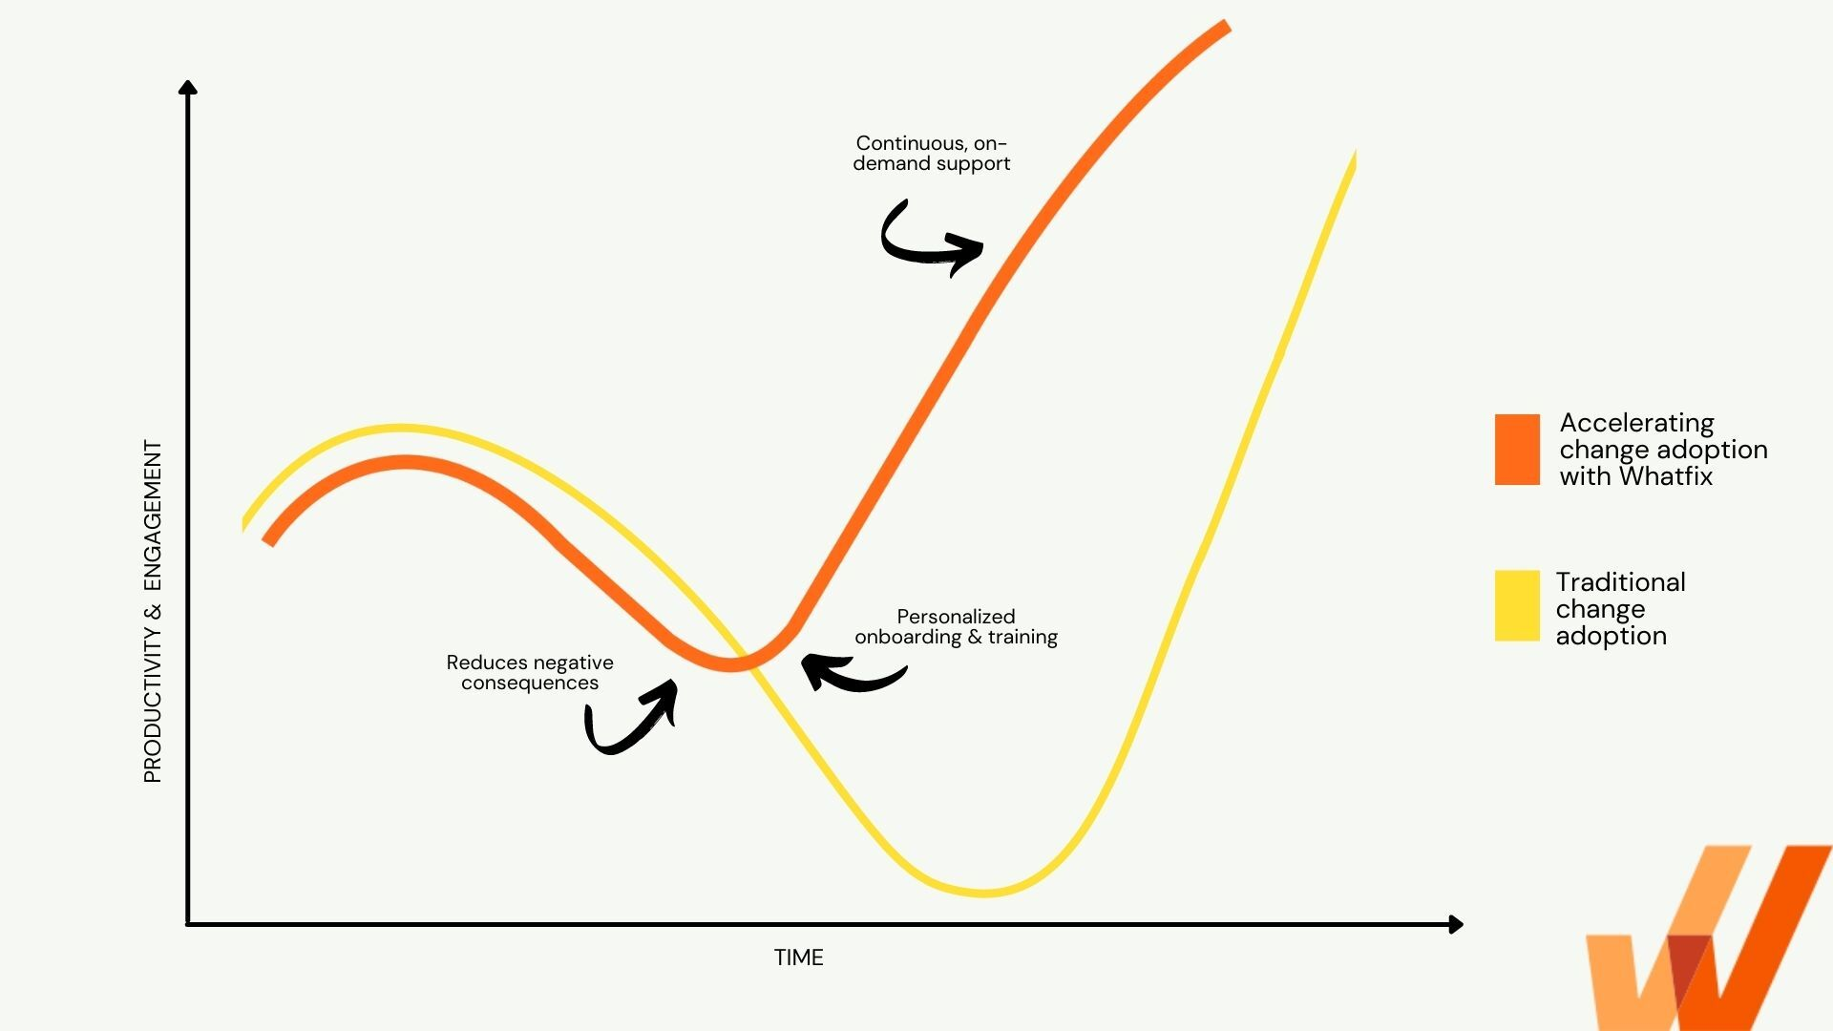
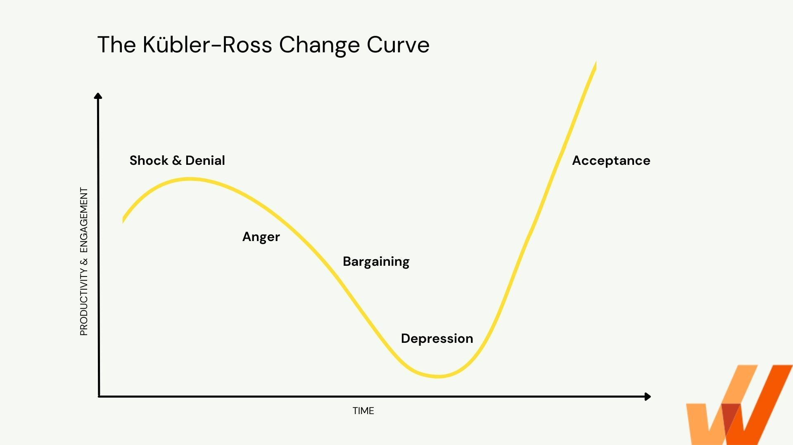
Introduce Process
Applying Change in Process → curve
Notes:
https://whatfix.com/blog/kubler-ross-change-curve/

Slide 7
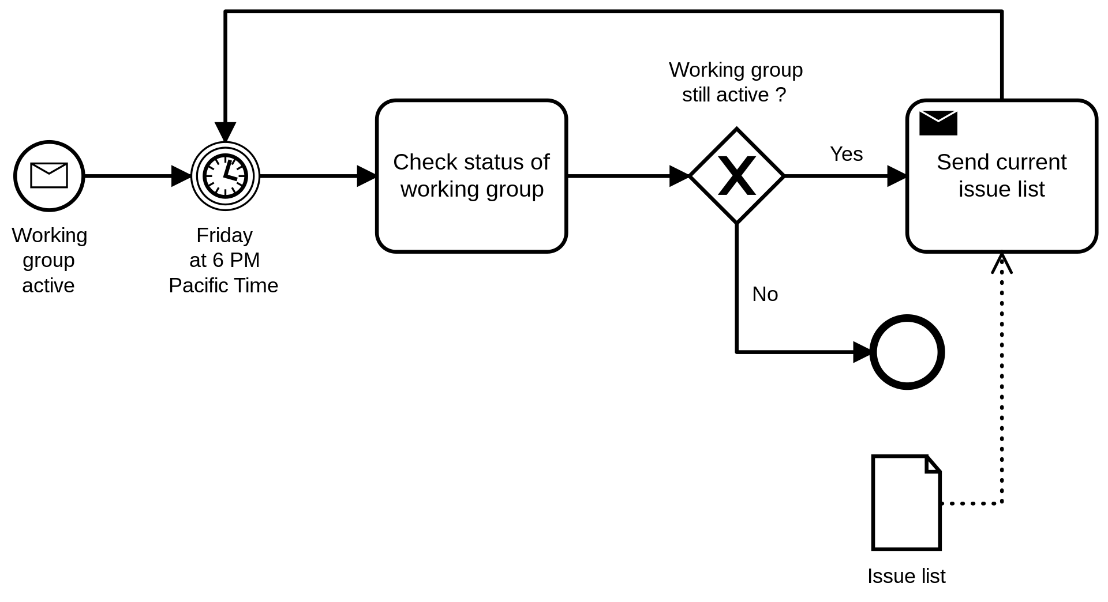
Introduce BPMN
- A graphical representation for specifying business processes in a business process model.
PROCESS 01_Guideline for drawing process flowchart by BPMN language in Viettel Peru
Appendix 01_Guideline for using BPMN notation to draw flowcharts
Appendix 02_Rules for checking flowcharts in BPMN
Notes:
Common language for technical, business talk together about processes
http://process.bitel.com.pe/bizagi/Process%20request%20PC%20for%20new%20employee/index.html#list

Slide 8
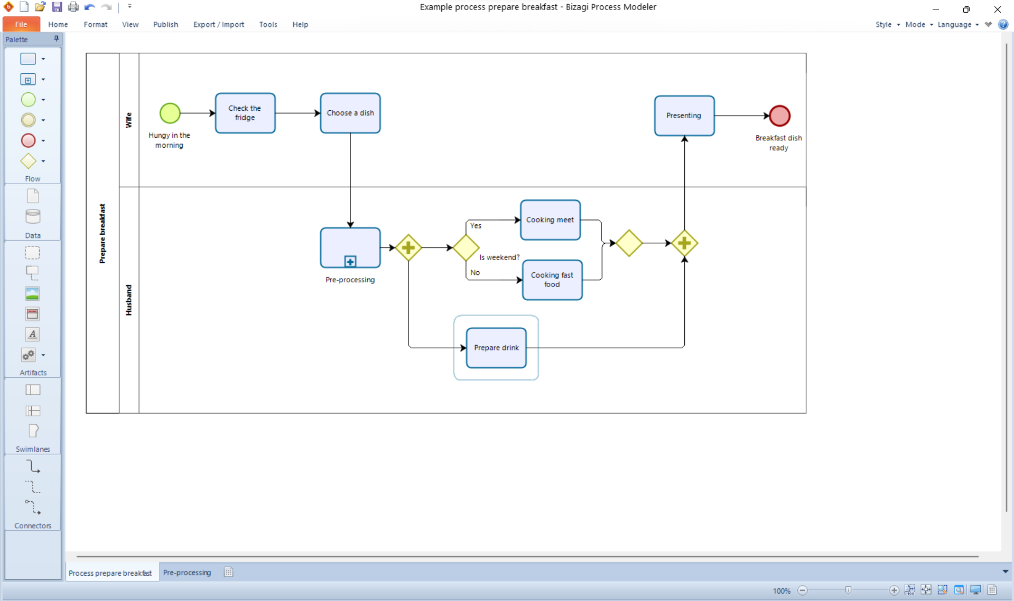
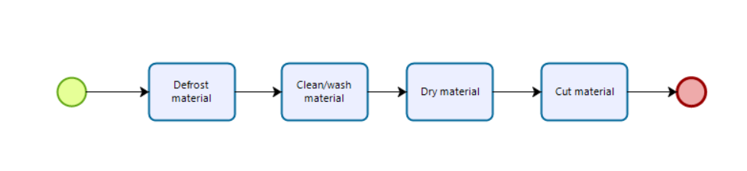
Guide to use Bizagi tool
Appendix 03_Guideline for using Bizagi to draw the BPMN process

Slide 9

Questions & Answers

